Slide 1

Abroad Squad + Chris
Ciao!
Patrick Zambri, Bradford Harris, Marisa Proscia, Chris Siena, Jacob Levinson

Slide 2
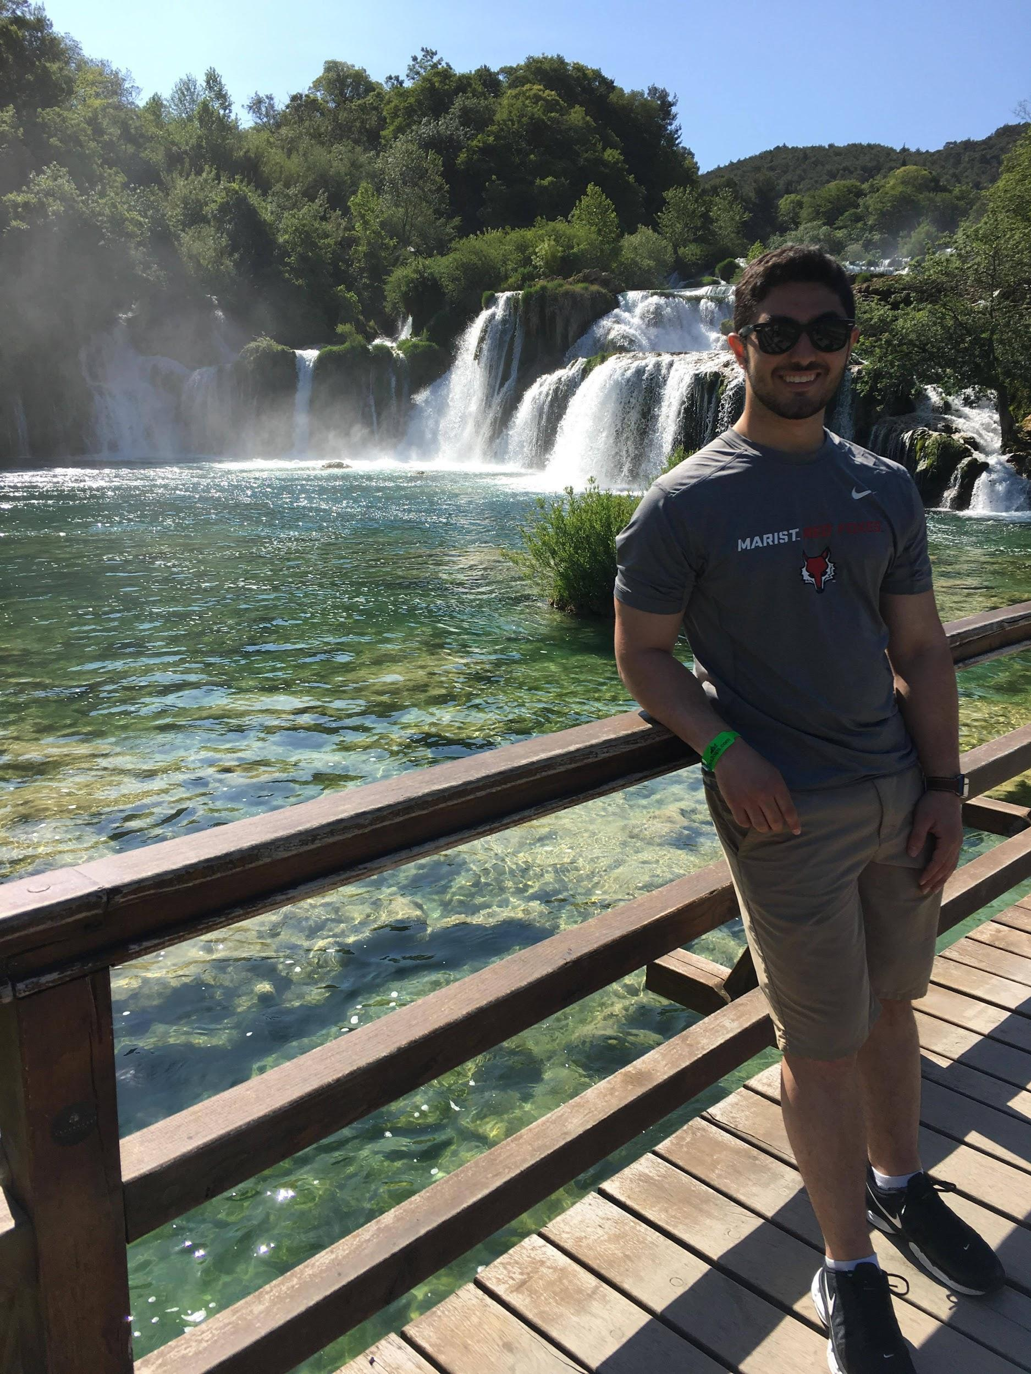
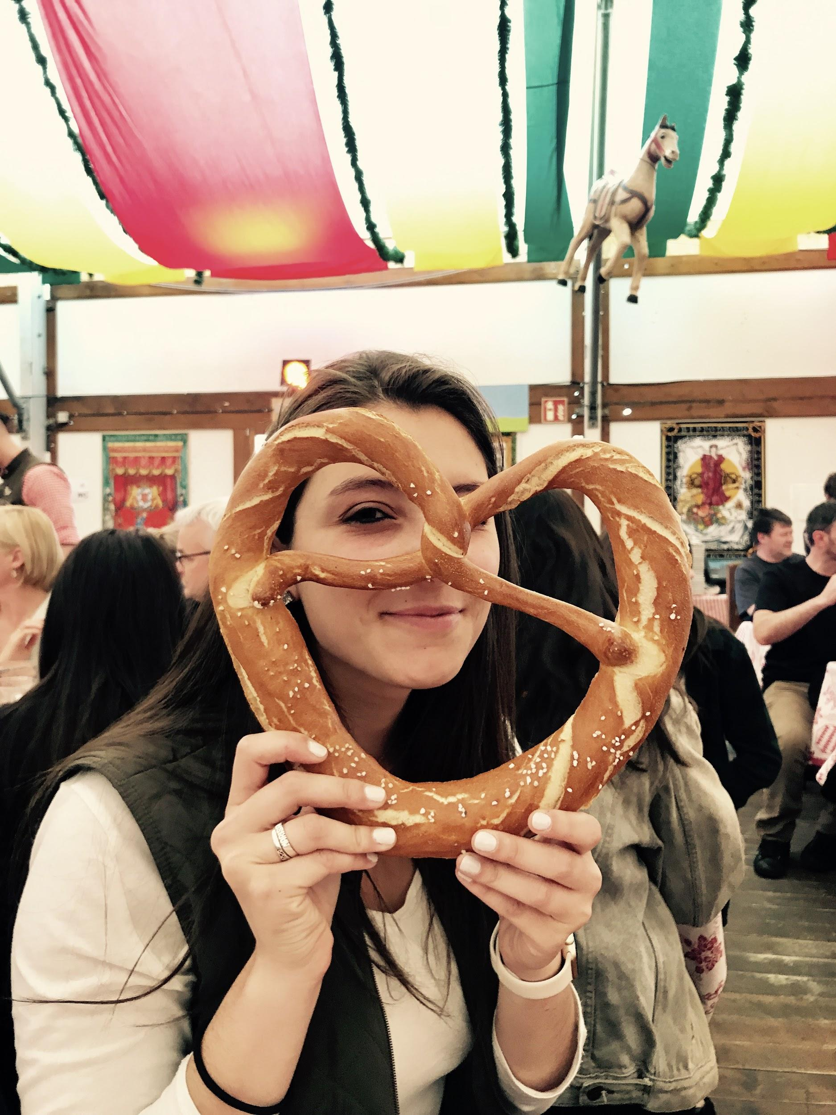

Team Pictures
(Pat)
(Pat)

Slide 3
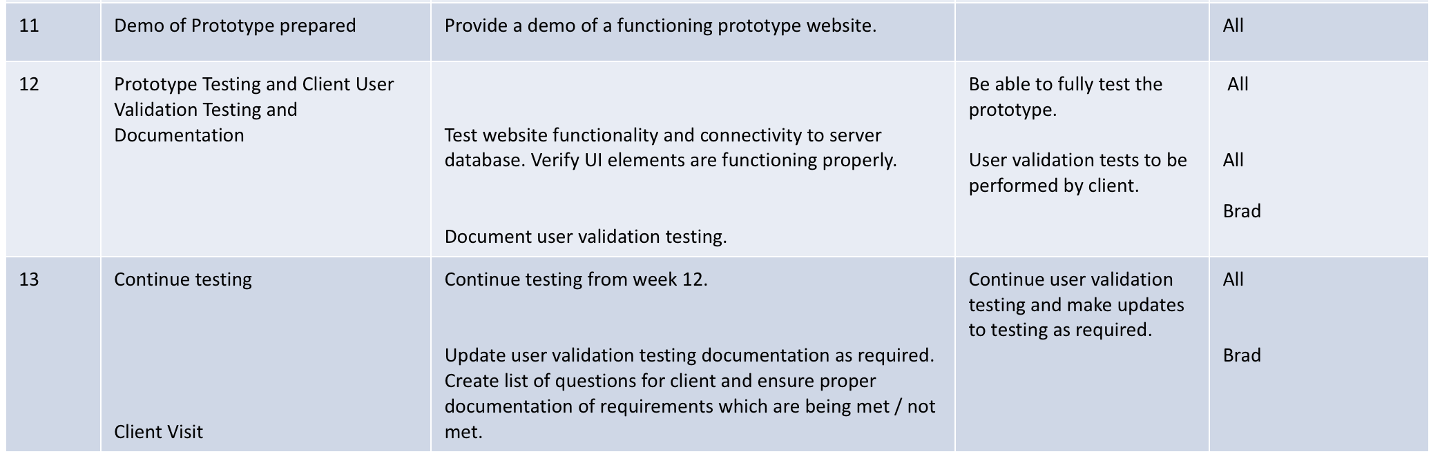
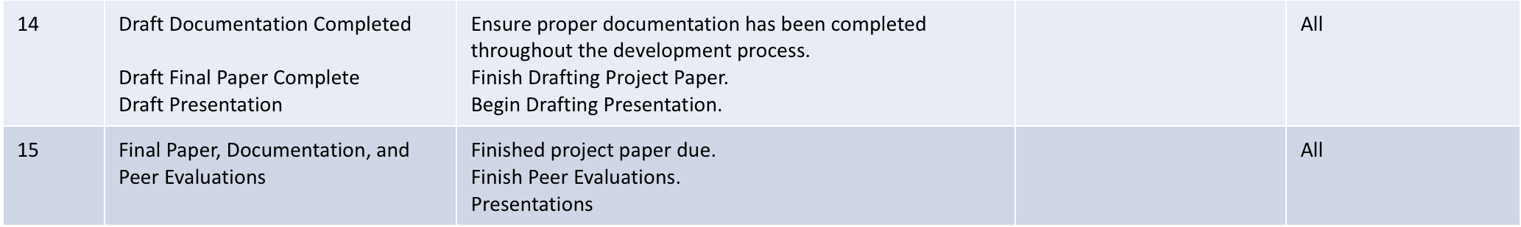
Schedule

Slide 4
Project Status
 | Technical | Website functionality: image upload, edit addressing, profile editing, calendar functionality, password resetting, recently contacted, life events
 | Resource | Documentation and resource organization wireframes, diagrams, development documentation, IT/server/database documentation
 | Technical | Finalizing Mobile UI and tweaking design elements
 | Resource | Presentation drafting and organization
 | Technical | Load balancing complications
 | Technical | PHP Mailing is restricted by host provider

Slide 5
Project Progress
Accomplishments
Calendar is functional, image upload, profile editing, password resetting, recently contacted, life events
Activities Being Worked
Finalizing functionality (Relationships, change coaches, add new sites)
Finalizing UI (mobile layout and other minor tweaks)
Testing
Documentation, organization, presentation (ERD, Wireframes,
Roadblocks
N/A

Slide 6
Scope of Project
What it is | What it is not
Website | A desktop or mobile application

Slide 7
Project Risks
Risk | Score | Mitigation
Time .. Nothing new | High | Keep working.

Slide 8
Project Issues
Issue | Owner | Action Plan | Checkpoint Date
Time | Everyone | Keep developing | 11/1/2017
Still time...

Slide 9
Lessons Learned
Lessons Learned | Corrective Action / Recommendation
Gathering Client Requirements is the most important step in the development process | Ensure all clients needs are going to be satisfied by the system design by asking questions before and during the development process.
Always ask for help | It is great to work out a solution on your own, but in some scenarios it is best to reach out to others for assistance, versus spending too much time on something.
Encryption troubles | Learned how to correctly install and configure MCrypt on ubuntu 14
Mobile First! | We picked Bootstrap as our CSS Framework because of its push for a responsive mobile UI.
Apache is Case-sensitive | We ran into a problem with our files claiming they were not deployed on the server. It turns out some were uppercase and some were lowercase. We figured it out now.
Google & Amazon block PHP Mailer on their servers | Have the functionality there incase it becomes available.
Cannot load balance on Google Server because there is only one | Discuss how we would go about load testing.

Slide 10
Communication Matrix
Stakeholder Name | Information Required | Timing / Frequency | Delivery Method | Owner
Client (Professor Rivas) | User Requirements | As Needed | Forum Posts, via email | Entire Team
Team Meeting | Team updates, system updates, complete homework | Meet weekly , communicate almost daily | In-Person Meeting, Group Chat | Entire Team

